Slide 1

Online Betting Platform Analysis

Slide 2
Overview
The given project consist of list of 208K players, their details and their activities over the betting platform.
Based on the given data and depending on the stakeholders, the data is to be analysed for the desired purposes and the analysis is to be presented in the form of graphs and charts using Power BI.
An online casino in India is an internet gambling platform offering slots, table games, and live dealer gaming opportunities. In some cases, sports betting possibilities are offered on the same platform.

Slide 3
Objectives
To analyze the trend, group and nature of players subscribing to the platform.
To find out the nature of activities performed by players and most used products on the platform.
To analyze the pattern of player’s the bet and deposit amounts.
To find out the most used platform used by players to subscribe.
To find out the actual business, the company is making

Slide 4
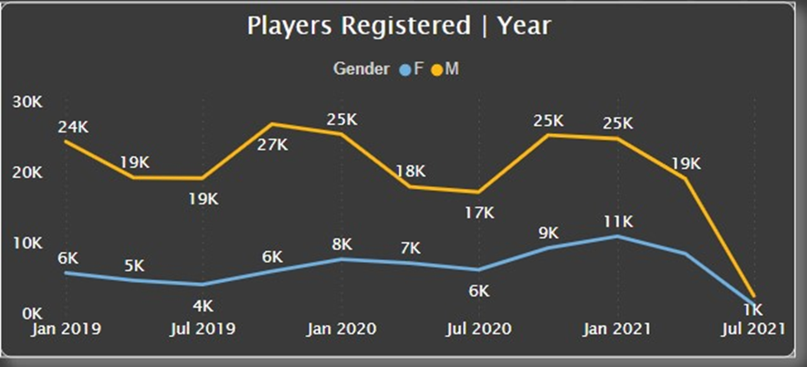
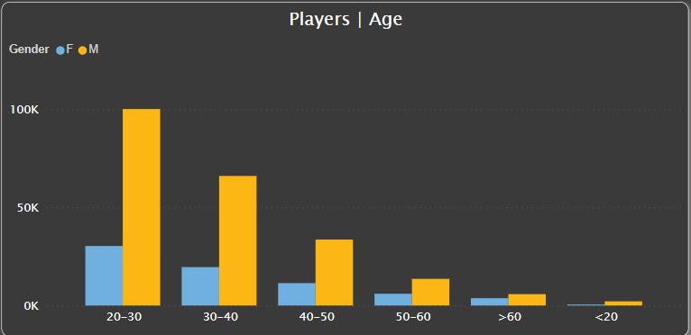
Player’s Nature in terms of Registration
Over the time registration of players is going down for both the genders.
Registration peaked around the second half of 2019 and in July 2021 it hit the least.
Female numbers are almost 1/3rd the number of Males but female's numbers haven’t seen huge decline like males.
Trend is same in both males and females, majority of the players fall under the age bracket of 20-30 and least under the age bracket of under 20.

Slide 5
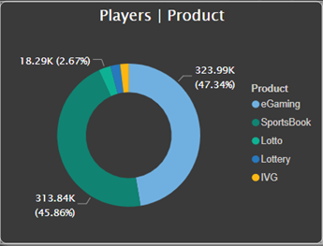
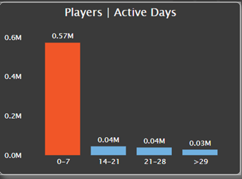
Player’s Activities on the platform
Mostly players are active for around only 0-7 days in a month
Most favorite products among the players are Sports eBook and e gaming, respectively. Contributing to around more than 90% traffic on the platform.

Slide 6
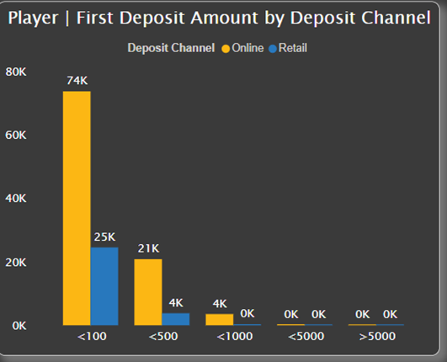
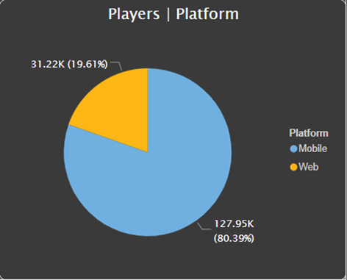
Platforms used by Players to register
Most of the players are depositing amount around 0-100 Rs in the platform through online platform
Somewhere around 80% players are using mobile phones to use the platform and only 20% users are using web platforms.

Slide 7
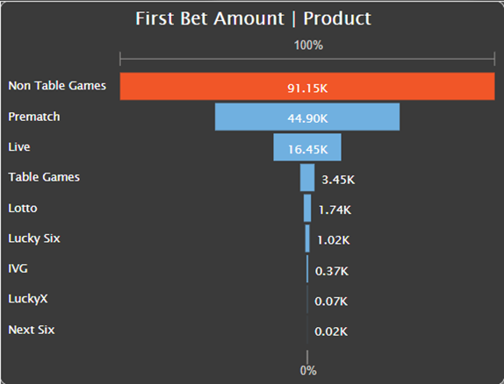
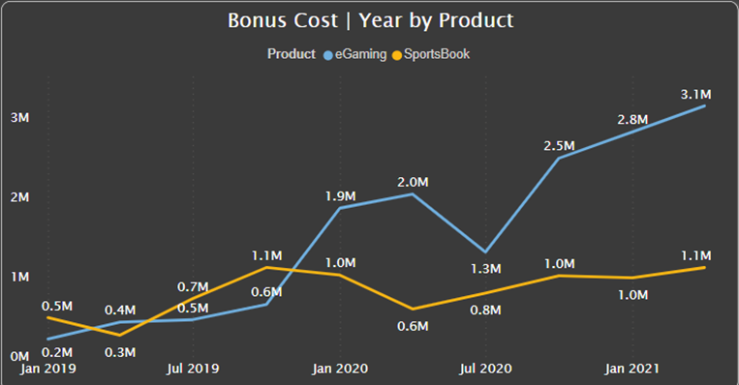
Bet Amount Analysis
Non table games and prematch are most popular sub -products for the players to bet on.
Egaming has shown the huge increase in terms of Bonus cost over Sportsbook.

Slide 8
Findings
Total 293 K players have registered betting on 9 products present over the platform.
Egaming and Sportsbook are the most common products catering around 90% of the betting
Marketing team should focus on other products also to engage the players over them.
Number of male users are much more than female members so some products specially catering to female interests should be launched to cater female users.
Business and marketing teams should focus on the application as most of the players are using cell phones to use the platform. Some offers on online method of payment should be introduced as most of the players are using online method only.
1.76-billion-dollar worth bets have made till now whereas Bonus cost is around 23 million dollar.
Company have made around 50-million-dollar net gross revenue till now.

Slide 9
Thank you for your Attention

